Slide 1
Dinghy
Mattias, Niklas, David, Fredrik, Jesper, Alexander, Björn

Slide 2
Hur ser systemet ut?

Slide 3
Sensor Node
Main Board

Slide 4
Responsibility
Sensors
Fredrik
Position and Orientation
David
Component Communication
Jesper
Real-time feedback
Niklas
Application
Alexander
Logging and statistics
Mattias
Energy
Björn

Slide 5
Position and Orientation
ADIS16209 for inclination
MEMS accelerometer
SPI

Slide 6
Sensors
Pressure sensor for centerboard (and rudder)
Strain gauges on centerboard
Ultrasonic sensor for height of centerboard
Optic sensor for measuring strips on centerboard
waterproof solutions for mounting sensors

Slide 7
Components and Communication
RN42 bluetooth module (with antenna)
Smartphone -> Mainboard -> Sensorboards
UART
Microcontroller STM32F401 suitable
Notes:
Mainboard med IMU och höjdsensor, sensor boards med trycksensorer
Processor STM32F401 har funktionalitet som behövs samt det finns erfarenhet med utveckling på denna.RN42 bluetooth modul är vanlig och har funnits på marknaden ett tag så support dokumentation finns.
Dgps är oklart om hur man skall lösa denna.
Blueooth mellan alla boards samt smartphone

Slide 8

Application
Done
Main views are created
Views have a planned UI
Feedback view and recordings
Performance margins,calendars, routing history

Slide 9
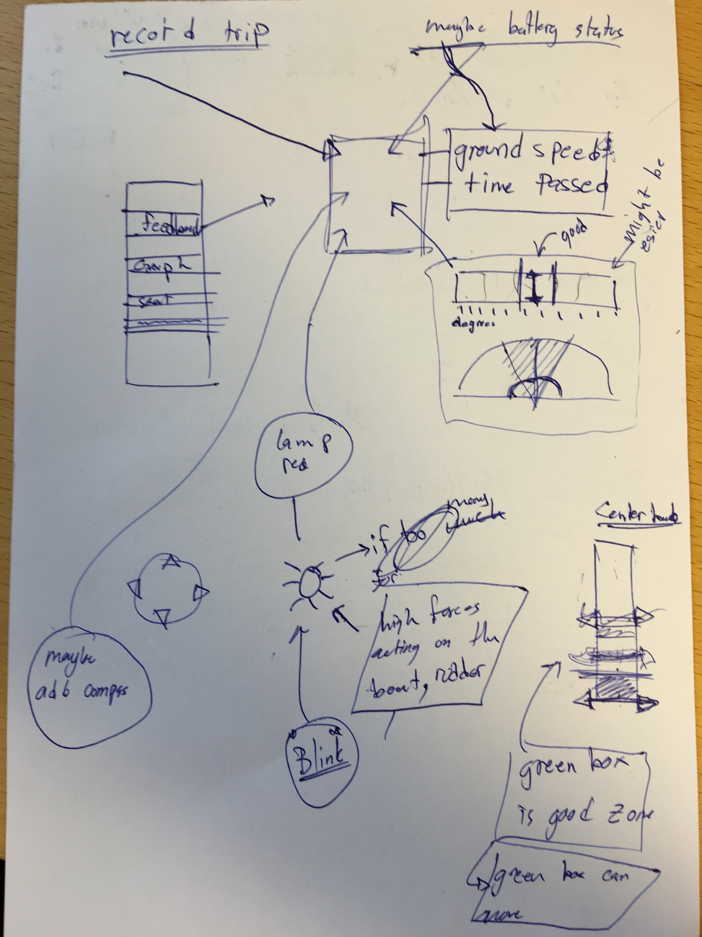
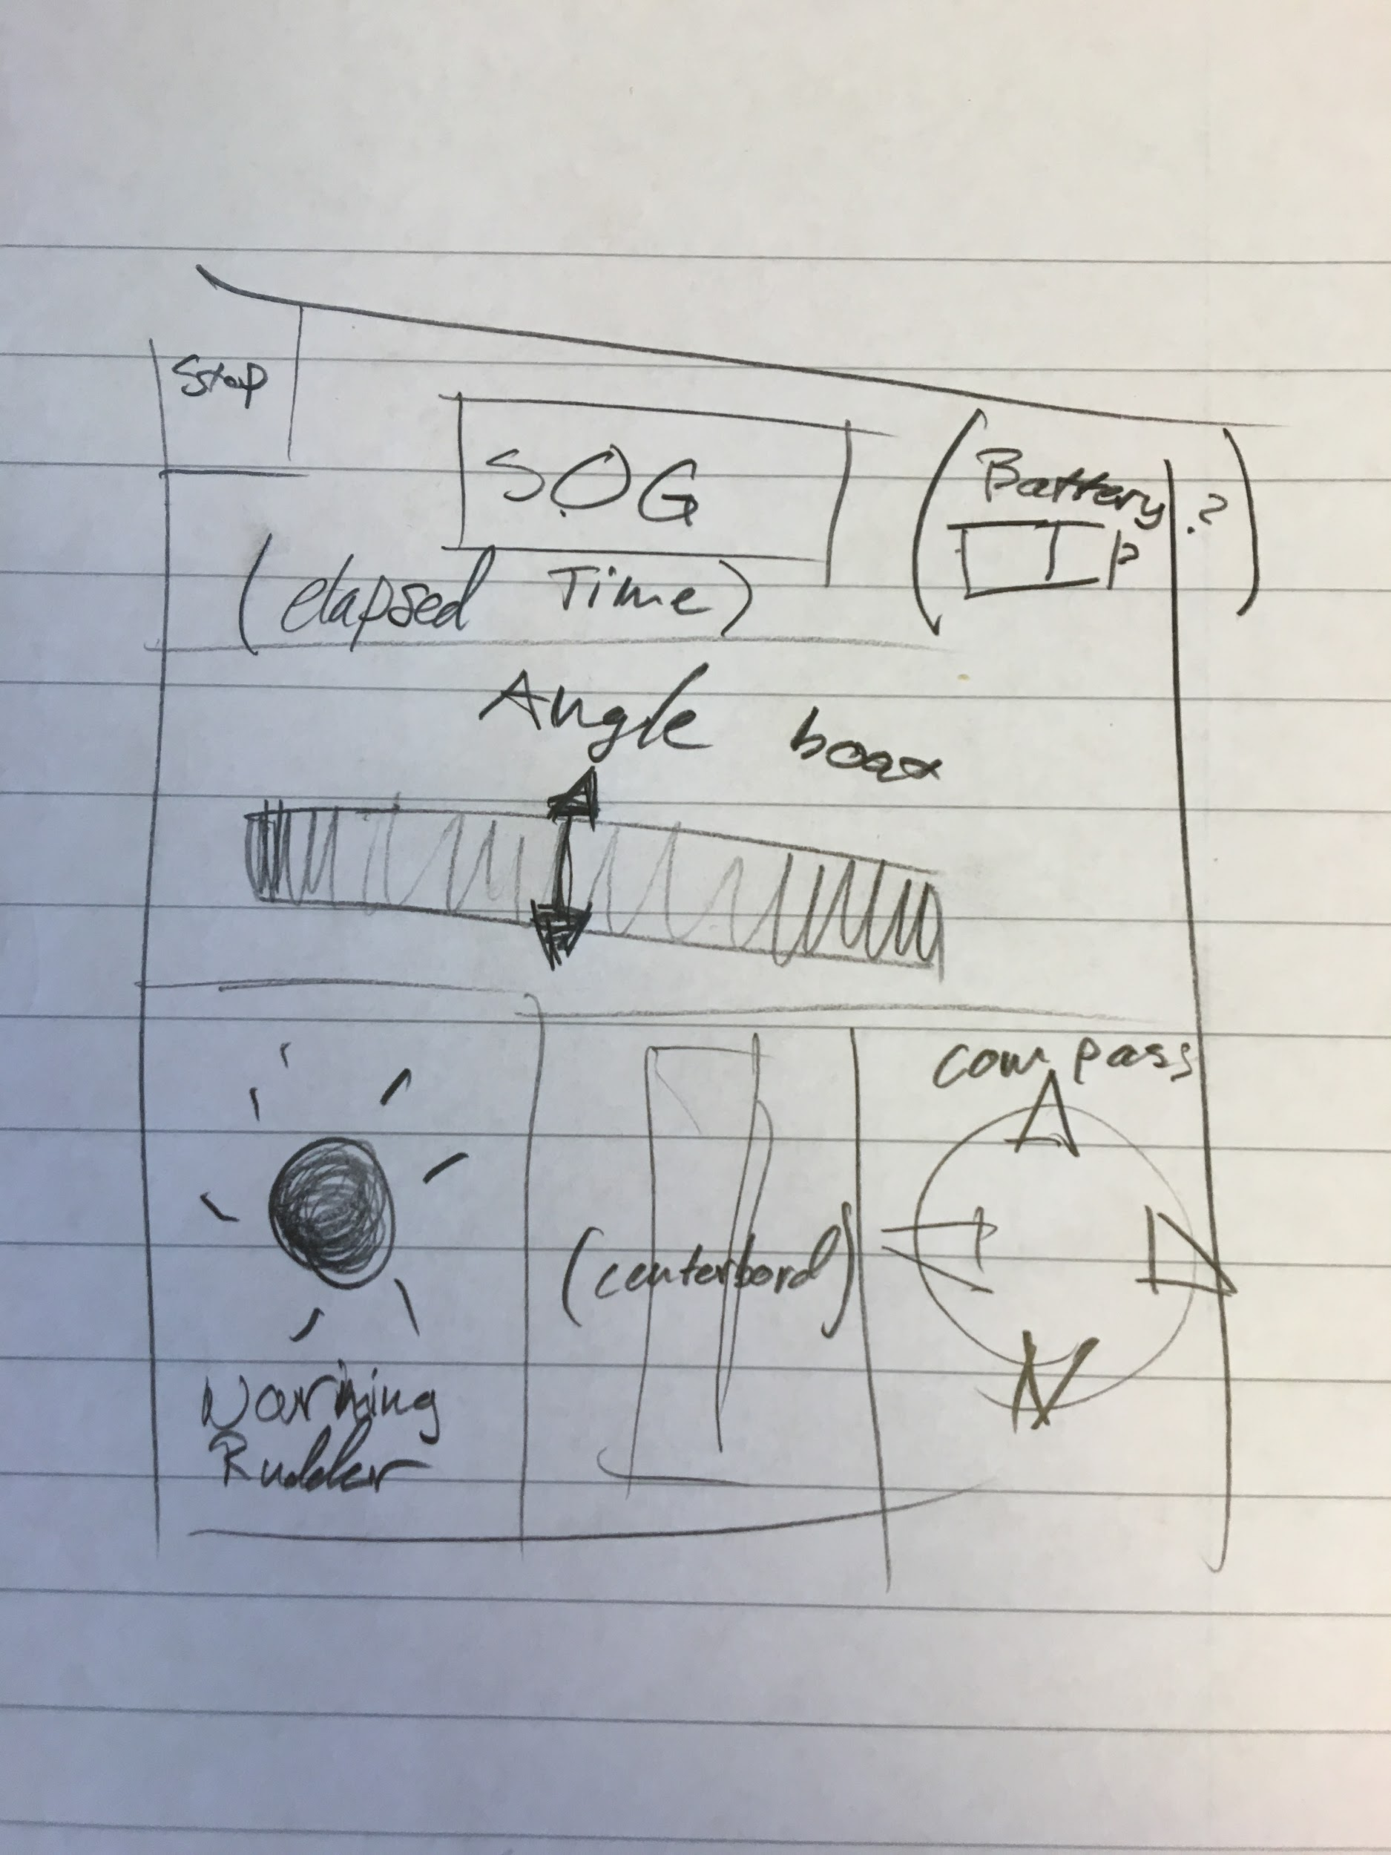
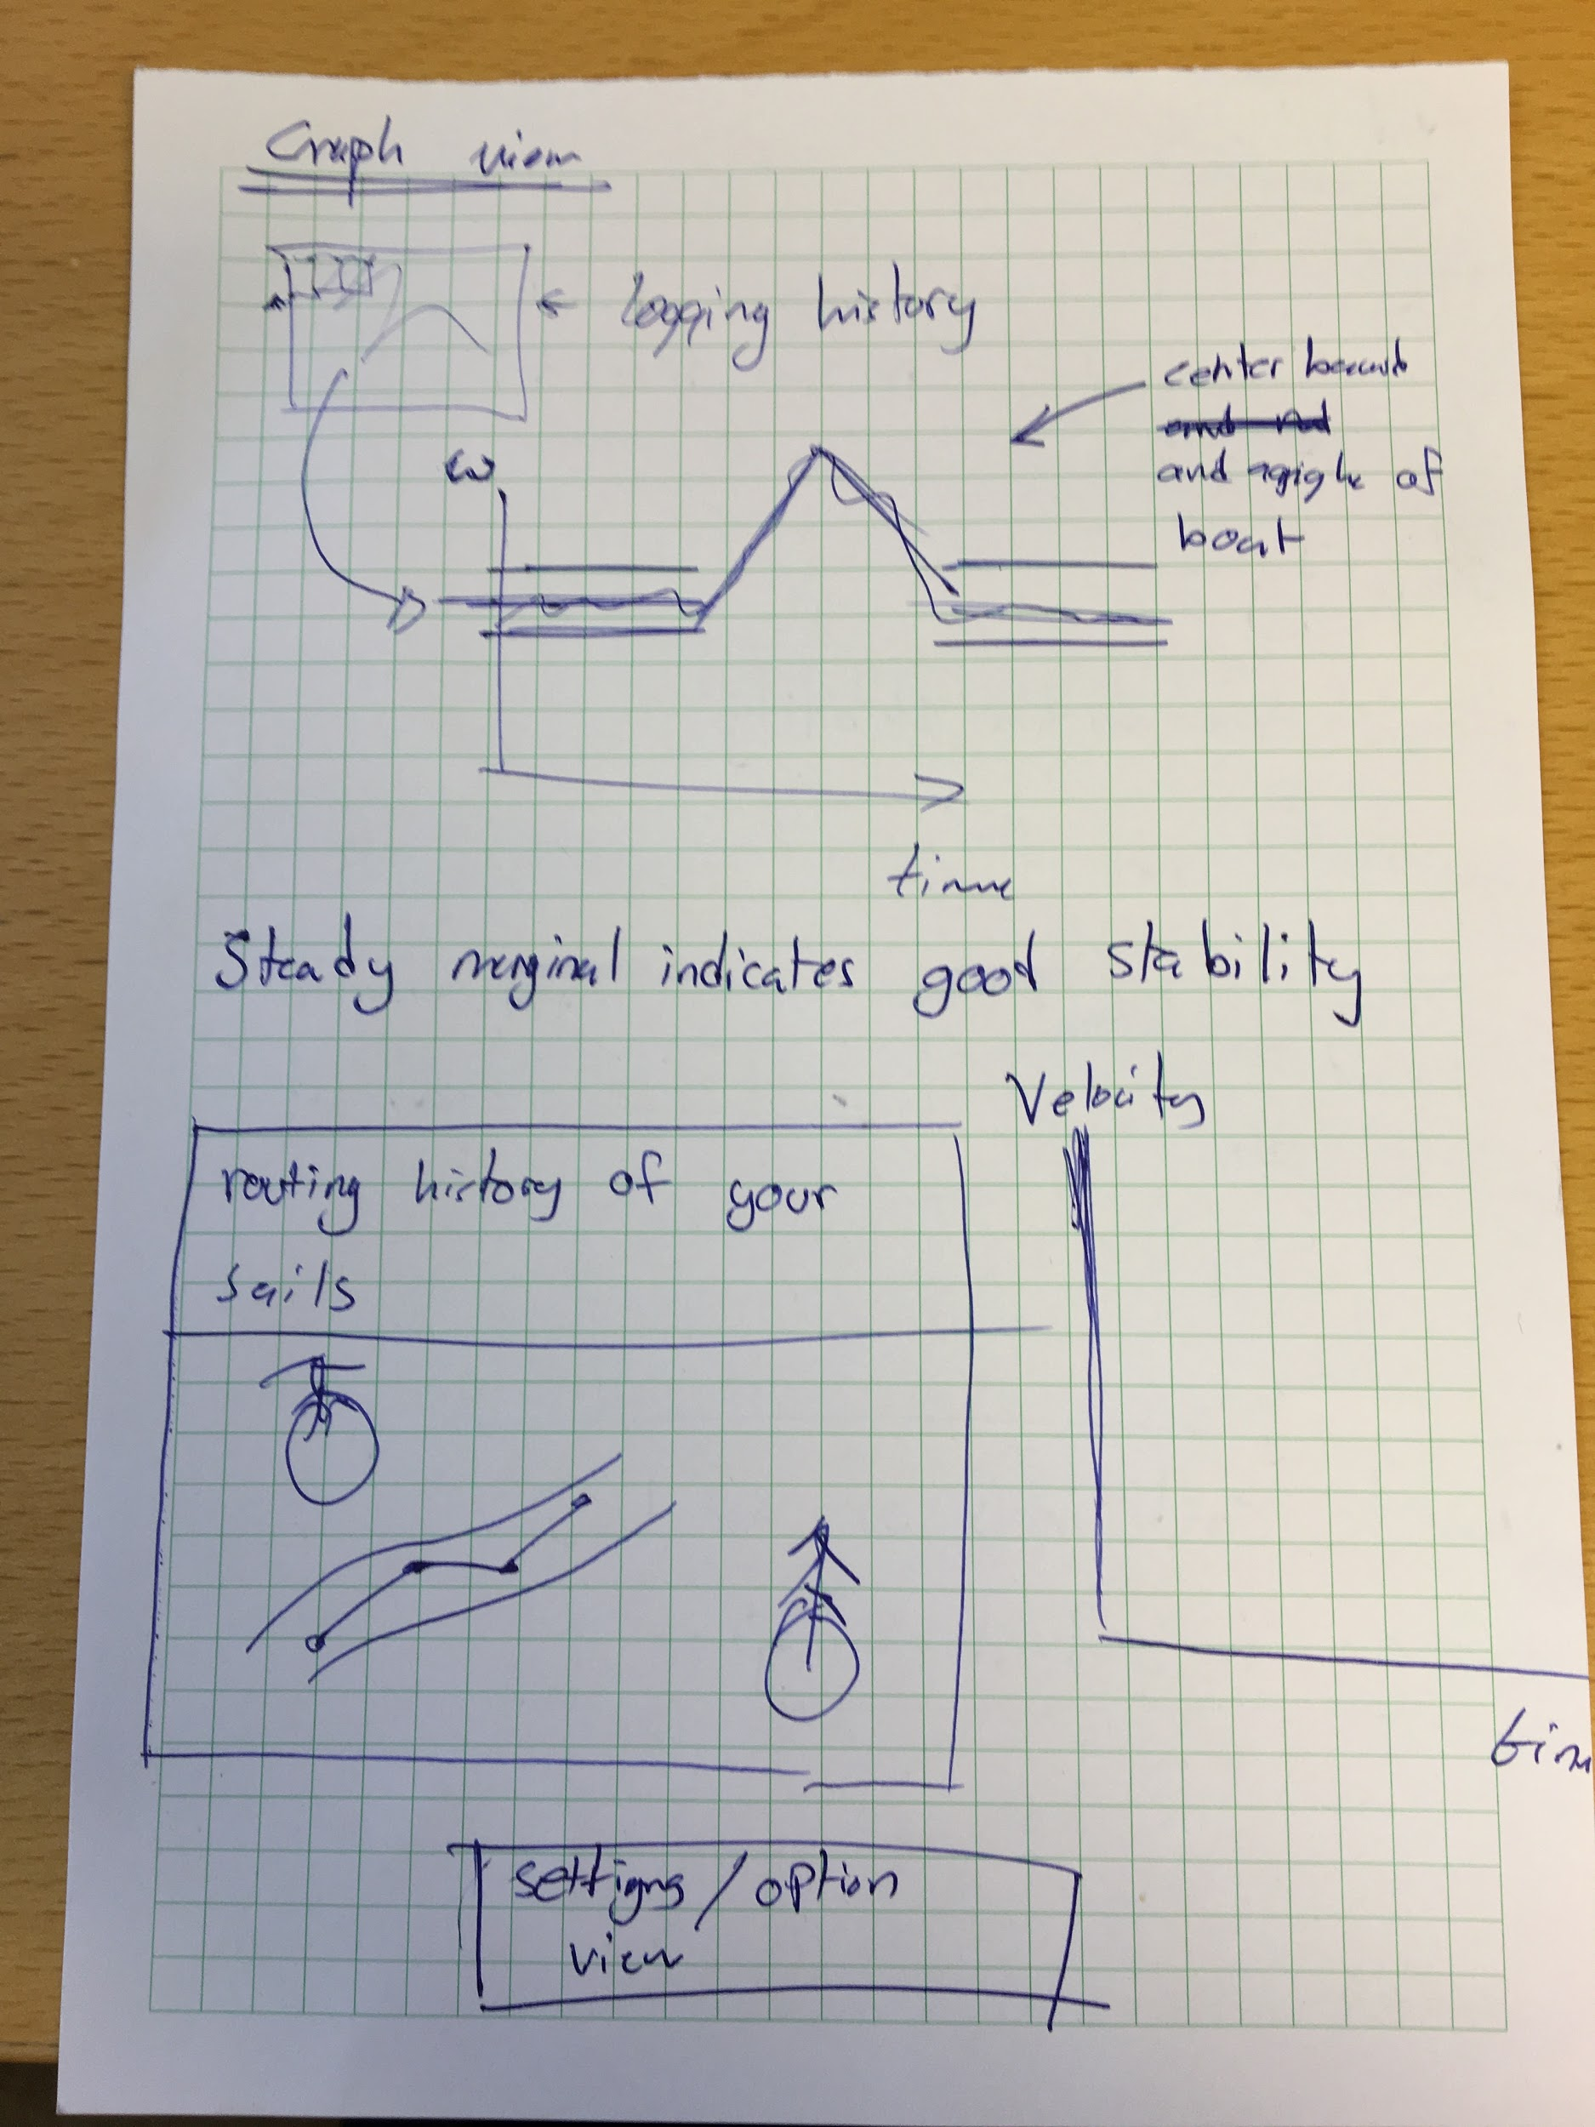
Application
Ideas

Slide 10
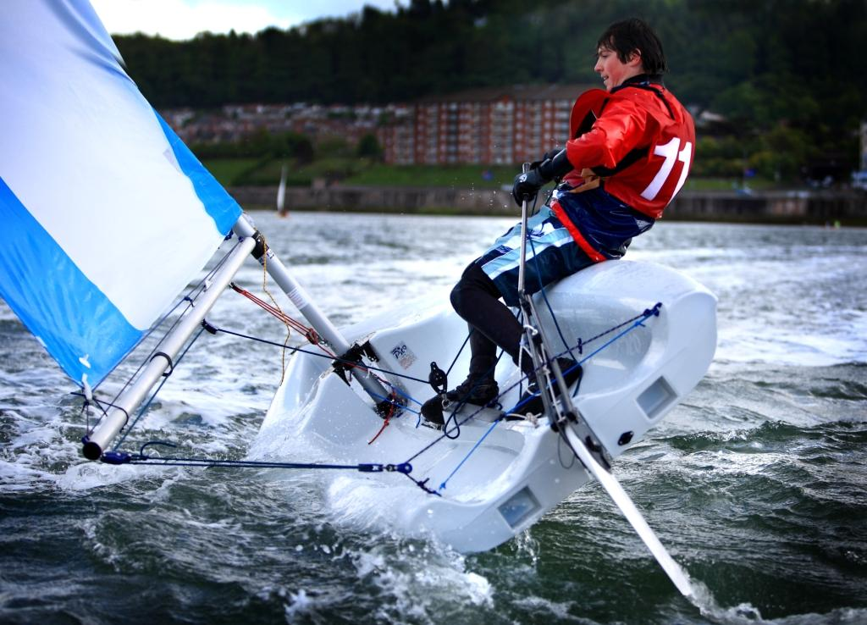
Real-time feedback
Been in touch with LSS
Setting up other interviews for next week

Slide 11
Logging and statistics
Binary files
( ( 4 + 1 + 3*2 + 2*4 + 4 ) * 2 *3600 ) * 45* 4 = 29,808,000 = 30mb/year
( ( p + h + gyro + gps + time ) * two times * 3600 ) * 45 days * 4 hours
ASCII files are more complicated to optimize
Can be many times larger than binary

Slide 12
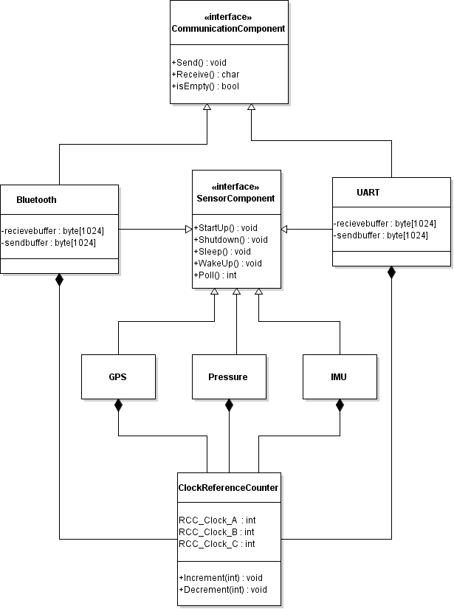
Energy
Gating the clocks to the APBx and AHBx peripherals when they are unused.
Reference counters for clockregisters
Disable clock when clock users = 0
Saves power
Lower power when lower clocks

